Slide 1



TEAM
KKB

Slide 2


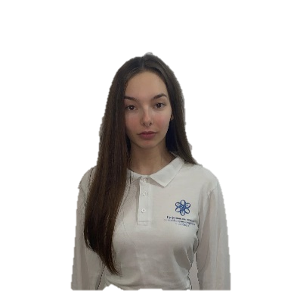

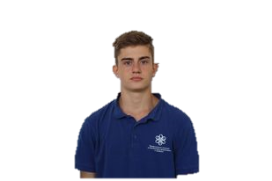
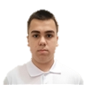
TEAM KKB
Back-end Developer
Scrum Trainer
Front-end Developer
QA Engineer

Slide 3

2
Introduction
We are Team KKB and we are gladly presenting you our final result.
Our aim was to deliver a program which represents information about each school with the students and their teachers in there.
Where they can be carefully distributed by our software in teams in order to work together.

Slide 4

Purpose
and description
The purpose of our project is to deliver a software for easily grouping the students and teachers in teams in each school
The project represents site where you can find our software which helps to group/regroup the teams

Slide 5





Process
Discuss ideas
Refine
Create a common purpose
Communication
Prioritize work
Document everything in github
Improve time management
Final product

Slide 6

Future goals
Expand our project (to help people in real life)
Upgrade website
Add more features

Slide 7


Slide 8





THANK YOU FOR YOUR ATTENTION!

